Slide 1
Professional Front-End Web Development
Introduction

Slide 2

Course Breakdown
Introduction
HTML & HTML5
CSS
Bootstrap

Slide 3
The Anatomy of a URL
https://qa.consultinguk.com:80/2016?s=AWS#respond
https:// – Protocol. How your browser should communicate with a web server.
qa. – Subdomain. A sub-division of the main domain name.
consultinguk.com – Domain Name. A unique reference that identifies a website.
:80 – Port. Rarely Visible but always required.
/2016 – Path. Refers to a file or directory.
? – Query. Used to attach parameters to the URL.
s=AWS – Parameter. Snippets of information found in the Query.
#respond – Fragment. An internal page reference, also referred to as an anchor.

Slide 4
Protocols
HTTP – Hyper Text Transfer Protocol
HTTPS – Secure HTTP
FTP – File Transfer Protocol
Email:
SMTP – Simple Mail Transfer Protocol – Used to send e-mail.
MIME – Multi-purpose Internet Mail Extensions – used to send multimedia across TCP/IP networks.
POP – Post Office Protocol – downloads emails from the server once it connects.
IMAP – Internet Message Access Protocol – lets you view your emails and decide whether to download them from the server or just remove them.

Slide 5
HTTP
HTTP is a stateless protocol.
Each command is executed independently, without any knowledge of the commands that came before it.
Errors on the Internet can be quite frustrating — especially if you do not know the difference between a 404 error and a 502 error.
These error messages, also called HTTP status codes are response codes given by Web servers and help identify the cause of the problem.

Slide 6
HTTP Methods
GET – Should be used to request a representation of a resource. GET should not change the state of the resource and should be idempotent.
POST – Should be used to create a new resource. POST should change the state of a resource and would not be idempotent.
PUT – Should be used to update the state of a resource. PUT should change the state of a resource but should be idempotent.
DELETE – Should be used to remove a resource. DELETE should change the state of a resource and be idempotent.

Slide 7
More HTTP Methods
POST & GET are universally supported.
PUT & DELETE are not usually supported by modern web browsers so should only be used for communication between services.
HEAD, TRACE, OPTIONS & CONNECT are the other HTTP methods that are less used.

Slide 8
HTTP Status Codes
Every response has a HTTP code associated with it.
There are around 60 different status codes separated into 5 categories:
1xx – Informational.
2xx – Success.
3xx – Redirection.
4xx – Client Error.
5xx – Server Error.

Slide 9
The Browser
The browser is how you view documents on the internet.
There are many browsers and all behave slightly differently.
However all browsers must support the viewing of HTML documents.
Not all browsers support things like JavaScript or may have them disabled so it is important to consider what browsers you expect your users to use.

Slide 10
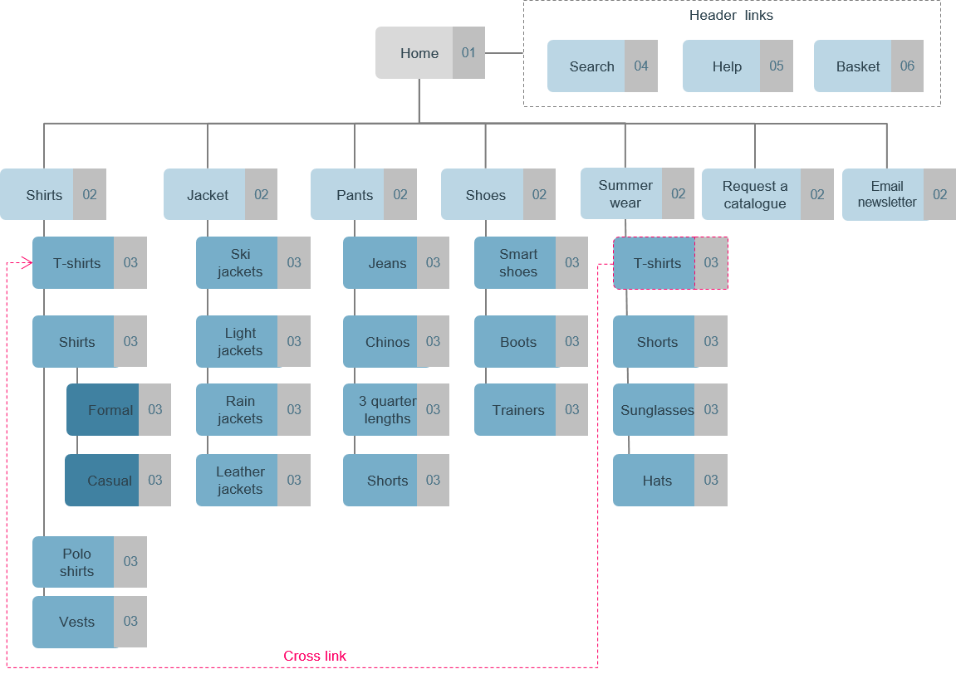
SiteMap
Sitemaps are used to provide a high level overview of what pages are needed.
It also shows the hierarches of the pages.
They do not show how users move through the site.

Slide 11
Who Uses the Sitemap?
Designers:
To see what wireframes/mock-ups are needed.
Content Teams:
To see what is to be produced.
SEO Teams:
To know the structure to advise on strategy.
Project Managers:
To understand high level structure.

Slide 12
HTML & HTML5

Slide 13
Objectives
To discuss what HTML is.
Gain Practical knowledge in HTML5.

Slide 14
HTML
HTML Stands for Hyper Text Markup Language.
It is used to specify the content and structure of web pages.
Like XML it uses opening and closing tags to build the documents structure .
Browsers interpret HTML tags in order to display the content specified within the file.
There are many versions of HTML with HTML5 being the most recent version

Slide 15
HTML5
HTML5 is a collection of technologies.
Browser support can be inconsistent, especially on slightly older browsers.
HTML5 is not case sensitive, but a consistent coding style is important.

Slide 16
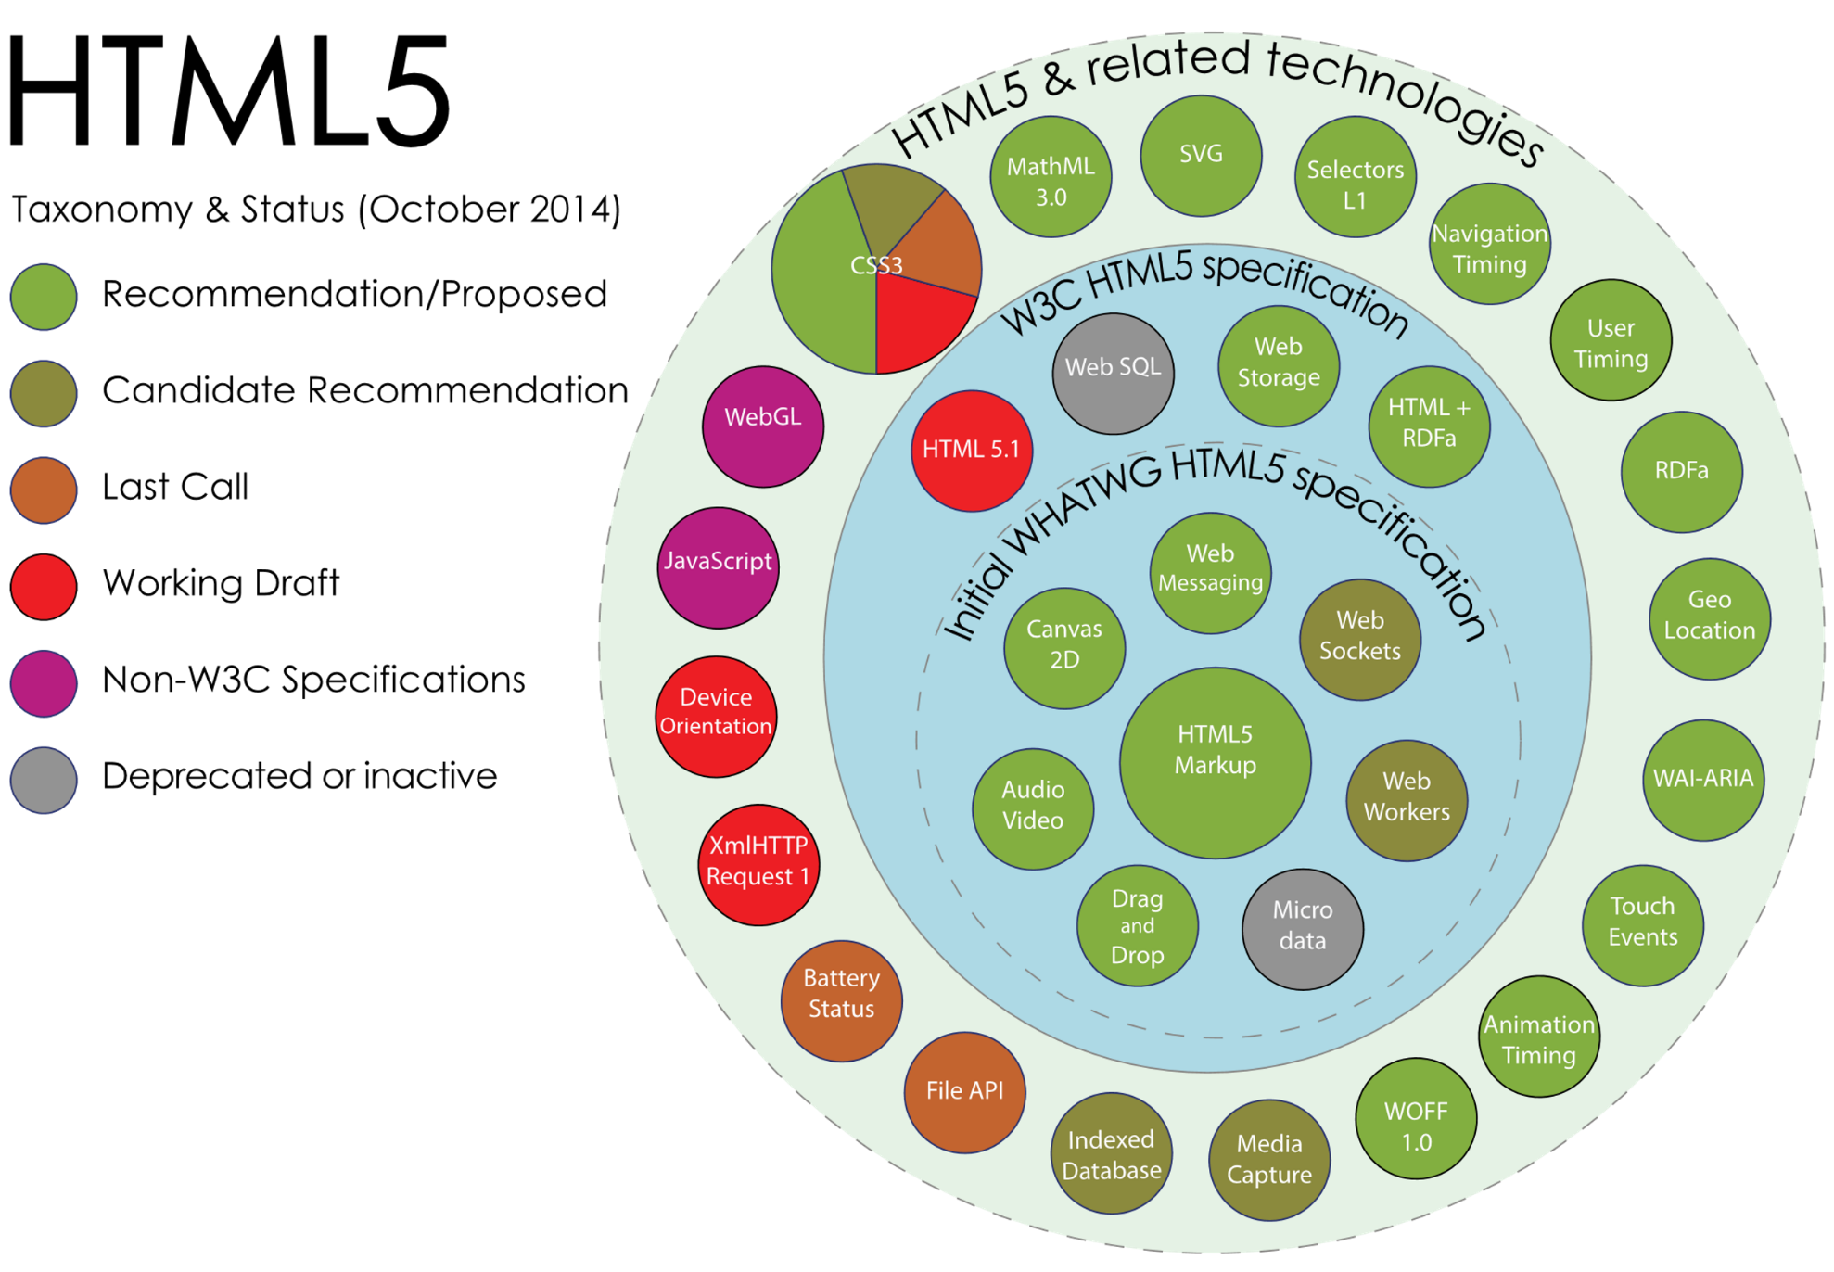
HTML5 Taxonomy & Status
We don’t need to know all of these to get started with HTML5 however it is useful to understand how HTML5 is structured.
By Mercury999 - Own work, CC BY-SA 4.0, https://commons.wikimedia.org/w/index.php?curid=36352535

Slide 17
Document Object Model
The DOM (Document Object Model) is a convention for representing and interacting with objects in a mark-up language.
This convention is cross-platform and language-independent.
The DOM utilises a tree structure to provide a logical and easily representable layout.
We can traverse this structure within code, travelling to nodes (objects) through the hierarchical layout.
The DOM in HTML is defined by the order of tags within the document.

Slide 18
Document Object Model
Document
<!DOCTYPE html>
<html>
<head></head>
<body>
<div id="header">
<h1>Welcome to WebExample.com!</h1>
</div>
<div id="content">
<h2>Homepage</h2>
<p>There is nothing on this website.</p>
</div>
<div id="footer">
<p>Contact admin@webexample.com to lodge a complaint.</p>
</div>
</body>
</html>
<html>
<head>
<body>
<div id=“header>
<div id=“content”>
<div id=“footer”>
<h1>
<p>
<h2>
<p>

Slide 19
Creating a new HTML file
Our file is split into 2 sections: head & body.
The head contains all the meta data for our page.
The body contains all the content.
<html> <head> <title>QA Gardens</title> </head> <body> Hello World </body> </html>

Slide 20
Structuring Content
<body> <div id="header">
<h1>Welcome to WebExample.com!</h1>
</div>
<div id="content">
<h2>Homepage</h2>
<p>There is nothing on this website.</p>
</div>
<div id="footer">
<p>Contact admin@webexample.com to lodge a complaint.</p> </div> </body>
Within the body we can use <div> tags to divide content.
We can use <nav> tags indicate that the contained content is a navigation element.
We can also use <section> tags to indicate page sections.
If we end a tag with /> then it removes the trailing tag (</tag>).

Slide 21
Attributes
We have already seen examples of HTML attributes in a few of our elements.
An attribute provides additional information about an HTML element.
The attributes available are different between each element, and the browser knows how to interpret each of them.
We always specify an attribute within the opening tag.
Attributes are defined by name/value pairs. ie. src=“logo.jpg”

Slide 22
When to use Each Structure Tag
If it’s a Major Navigation Block:
<nav>
If it Makes Sense on its Own:
<article>
If it isn’t Needed to Understand the Content:
<aside>
If its Logical to add a Heading:
<section>
If there's any Other Semantic Meaning:
<header>
<footer>
If you Reach This:
<div>

Slide 23
Adding images
<nav> <!-- Main Navigation --> <div> <div> <!-- Page Branding --> <a href="manage_stock.html"> <img alt="NB gardens" src="img/QA_logo_blue.png" width="50px" height="50px"/> </a> </div> <div id="navbar">
…
</nav>
Links to other pages are added using the <a> tag with href used to specify the destination.
Images are added with <img> with src used to specify the file.
alt is used to specify alternative text for screen readers.
Notes:
We can add comments using <!-- comments -->

Slide 24
Unordered and Ordered Lists
Here we are specifying a bullet point list using the <ul> tag.
If we wanted a numbered list we could use the <ol> tag instead.
Each point in the list is specified with the <li> tag.
<div id="navbar"> <div> <!-- Page Links --> <ul> <li><a href="manage_stock.html"> Manage Stock </a></li> <li><a href="replenish_stock.html"> Replenish Stock </a></li> </ul>
Notes:
Href stands for hyper text reference

Slide 25
Forms
Whenever we want to get an input from the user in a web page we need to use a form.
Forms are used to wrap inputs.
Inputs have a type which is used to bring up contextual controls on mobile.
Placeholders should be used with alts because if a user with a screen reader focuses on the input the placeholder disappears.
<form> <div> <input type="email" placeholder="email..." alt="Enter Email" required="required" /> <input type="password" placeholder="password..." alt="Enter Password" required="required" /> <button type="submit">Sign In </button> </div> </form
Notes:
Common ones are input type=“text” and “number”

Slide 26
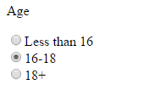
Radio Buttons in forms
When using radio buttons in a form we need to group them using the name attribute.
The name attribute allows us to group the buttons together.
Users can only select one button in each name group.
<form> <p>Age</p> <input name="age" type="radio"/>Under 16 <br/><input name="age" type="radio"/>16-18 <br/><input name="age" type="radio"/>18+ </form>

Slide 27
Sections, Headers, Footers & Bookmarks
The <section>, <header> and <footer> tags behave in the same way as a div.
They are used to provide semantic meaning.
We can use the <a> tag to move us around pages as well as between them.
We do this by setting the href to the id of another tag prefaced with ‘#’;
<div class="mainContent"> <section id="stockListSection"> <header> <h2>Product List</h2> </header> <!-- stock list --> <footer> <a href="#stockListSection"> top </a> </footer> </section>

Slide 28
Tables
If we want to make a table we can use the <table> tag.
To add rows within the table we use the <tr> tag.
<th> is used to specify a table header cell while <td> is used to specify a normal cell.
<tbody> can be used to separate the rows that make the body of the table.
<!-- stock list --> <table> <tr> <th>Product</th> <th>Quantity</th> <th>Status</th> </tr> <tbody> <tr> <td>Just Boots</td> <td>10</td> <td>ACTIVE</td> </tr> </tbody> </table>

Slide 29
Displaying text
We can use <h1> - <h6> tags to render text as headings.
The <p> tag is used to wrap a paragraph of text.
The <q> tag is used to wrap quotes.
There are many other tags that we can add to text to provide semantic meaning.
<section> <header> <h2>Manage Product</h2> </header> <div> <h3>Just Boots</h3> <p><q>The Booiest of all the boots</q> Integer dolor sem,…</p> </div>

Slide 30
<a> targets
_blank - Opens in a new window or tab.
_self - Opens in the same window/tab as it was clicked (this is default).
_parent - Opens in the parent frame.
_top - Opens in the full body of the window.
framename - Opens in a named frame.
</div> <footer> <button>Edit</button> <button>Discontinue</button> <a href="…" target="_blank"> View on Store front </a> </footer> </section> </div> </div> </body> </html>

Slide 31
CSS/CSS3

Slide 32
Objectives
To discuss what CSS is.
Gain Practical knowledge in CSS.

Slide 33
What is CSS?
CSS stands for Cascading Style Sheets.
CSS is used to change the look and feel of our HTML content.
Think of HTML as a chair and CSS as the fabric you use to cover the chair.
The Current version of CSS is CSS3 which was introduced in 1999.

Slide 34
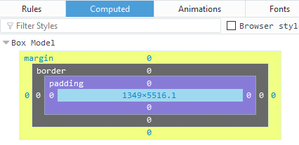
CSS Box Model
The CSS box model is used to help visualise where margins, boarders and padding are applied on HTML elements.
It can be found in the inspector within your browser by right clicking on a webpage.

Slide 35
Linking CSS to HTML
CSS files can be referenced by our HTML files by using the <link> tag.
By convention our CSS files belong in a dedicated folder.
This keeps our directories clean and makes it easier to find files.
<link href="css/style.css" rel="stylesheet" type="text/css" />

Slide 36
Example HTML code
<!DOCTYPE html><html> <head> <meta charset="ISO-8859-1"> <title>welcome</title> <link href="css/style.css" rel="stylesheet" type="text/css" /> </head><body> <div class="mainContent"> <div class="navigation"> <ol> <li><a id="home" href="www.qa.com"> Home</a></li> <li><a href="www.qa.com/about-qa"> About</a></li> <li><a href="https://www.qa.com/online-courses">Products</a></li> <li><a href="info@qa.com"> Contact</a></li> </ol>
</div> <div class="content"> <p>Vestibulum et ipsum non turpis ultricies pretium at ut enim. Fusce et arcu sit amet lorem consequat scelerisque. Ut vulputate metus ac ante interdum, ut scelerisque lectus scelerisque. Fusce placerat nibh eros, vel auctor nisl facilisis at. Suspendisse id rhoncus dolor. Vivamus ac velit ultricies, dignissim urna vel, posuere arcu. Nulla quis massa imperdiet, efficitur mauris in, gravida ante. In molestie tempor euismod. Maecenas at porta magna. Proin sed pretium lectus, at pretium leo. In tellus arcu, efficitur a nulla et, consectetur malesuada urna. Curabitur facilisis diam enim, non pharetra nibh tincidunt in. Vestibulum ipsum enim, rhoncus vitae luctus vitae, tempus eu sapien.</p> </div> </div> </body></html>

Slide 37
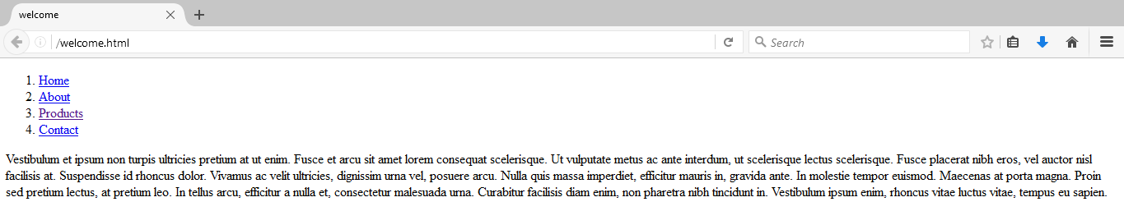
Example Code Without any CSS

Slide 38
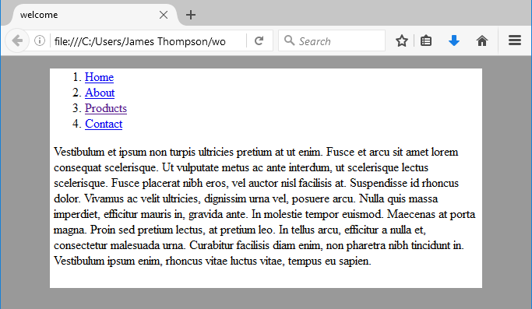
Adding some basic CSS
Within Style.css we define our CSS rules in key/value pairs.
For now we will apply styles to the <html> and <body> tags
@CHARSET "ISO-8859-1";
html { background-color: #999999; }
body { background-color: #FFFFFF; width: 80%; margin-left: auto; margin-right: auto; }

Slide 39
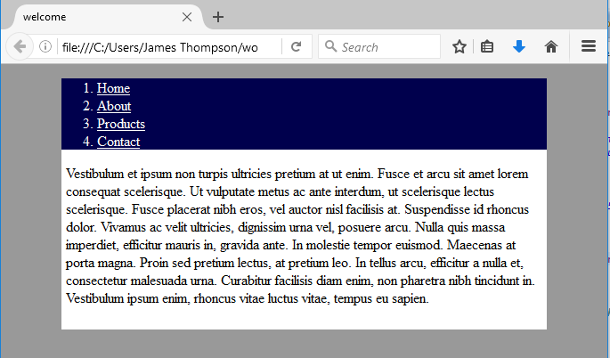
CSS Class Selectors
We can apply styled to groups of tags by assigning them classes using the ‘.’ selector.
.content { padding: 0px 5px 10px 5px; }
.navigation { background-color: #00004d; color: #FFFFFF; }
.navigation a:link { color: #ffffff; }
.navigation a:visited { color: #ffffff; }

Slide 40
CSS id Selector
To style individual HTML elements they need an id which can be access using the ‘#’ selector.
When applying styles to classes we can specify tags within that class by adding the tag to the selection separated with a space.
Elements such as <a> tags also have events which we can apply styles to.
#home { font-weight: bold; }
.navigation { background-color: #00004d; color: #FFFFFF; padding: 0px 0px 0px 0px; width: 100%; display: table; }
.navigation ol { padding: 0px 0px 0px 0px; margin: 0px 0px 0px 0px;
}
.navigation a:visited { color: #ffffff; }

Slide 41
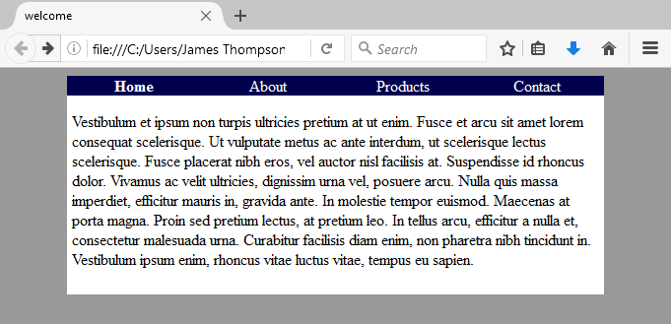
Finishing off the CSS
.navigation li { display: table-cell; text-align: center; vertical-align: middle; float: left; width: 25%; }
.navigation li:hover { background-color: #3333ff; }
.navigation a:link { color: #ffffff; text-decoration: none; }

Slide 42
Before & After

Slide 43
CSS
Bootstrap

Slide 44
Objectives
To discuss what Bootstrap is and why its important.
Gain Practical knowledge with Bootstrap.

Slide 45
What is Bootstrap?
Bootstrap is a very popular and widely used responsive framework.
When we call something responsive what we mean is that the page will adapt based on the device used to view that page.
Bootstrap is a collection of CSS and JavaScript which we link into our HTML and leverage with classes and id’s.
If HTML is the chair, CSS is the material we are using to cover the chair then Bootstrap turns that chair into a folding chair.

Slide 46
Linking Bootstrap CSS into our HTML
We link the bootstrap CSS in the same way we link our own CSS.
We can link multiple CSS files into a single HTML file.
We want our CSS to be the last stylesheet linked so that we can override bootstraps CSS not the other way around.
We also need the viewport to improve rendering and touch zooming.
<head> <meta name="viewport" content="width=device-width, initial-scale=1"> <link href="css/bootstrap.min.css" rel="stylesheet" media="screen"> <link href="css/main.css" rel="stylesheet" media="screen"> </head>

Slide 47
Linking Bootstrap JavaScript
For bootstrap to work properly we need to link in the javascript for both bootstrap and Jquery.
JQuery is a JavaScript library that focuses on adding animation and transitions to websites.
You can also see here how you can link JavaScript using both URL’s and JavaScript files packaged with the HTML.
<body></body> <script src="https://ajax.googleapis. com/ajax/libs/jquery/1.12.4/jquery.min.js"></script> <script src="js/bootstrap.min.js" type="text/javascript"></script> </html>

Slide 48
Making a Bootstrap navbar
We will be using the same code from the HTML example.
Here we are applying rules to our nav and div tags to move them to the top of the screen.
Each class will apply a couple of rules to manipulate the pages Structure.
navbar-fixed-top for example only sets the element to move with the user when scrolling
<nav class="navbar navbar-fixed-top navbar-inverse"> <div class="container"> <div class="navbar-header">

Slide 49
Burger Button
When the screen gets too small to display our navigation links we want them to collapse into an expandable menu.
We can use this bit of code to render that button when this happens.
The data-target is used by JavaScript to take any element within the specified id into the dropdown.
</a> <button data-toggle="collapse" class="navbar-toggle collapsed" data-target="#navbar" type="button" aria-expanded="false" aria-controls="navbar"> <span class="sr-only"> Toggle Navigation </span> <span class="icon-bar"></span> <span class="icon-bar"></span> <span class="icon-bar"></span> </button>

Slide 50
Making our Menu Collapsible
We want our menu links to be included in the dropdown so we will give the containing <div> the id of navbar.
We will also use the class of navbar-right to float the elements to the right of the navbar.
All of the classes we are applying we can override in our own CSS files.
<div id="navbar" class="collapse navbar-collapse"> <div class="navbar-right"> <!-- Page Links --> <ul class="nav navbar-nav"> <li class="navbar-brand"> <a href="manage_stock.html"> Manage Stock</a></li> <li class="navbar-brand"> <a href="replenish_stock.html"> Replenish Stock</a></li> </ul>

Slide 51
Navbar Form
We will be applying styles to our navbar form as well.
The btn class will style the button to look more buttony.
btn-success will make the button visually distinctive to other buttons.
</ul> <form class="navbar-form navbar-right"> <button class="btn btn-success"> Exit </button> </form> </div>

Slide 52
Bootstrap Columns
Here we are specifying how many columns we want each section to take up.
We can change the number of columns based on the size of screen.
The sizes are lg, md, sm and xs.
We must have a div with the class of container wrapping any column classes
<div class="mainContent"> <!-- Main Content --> <section id="stockListSection" class="col-md-3 col-sm-4"> <!-- stock list --> </section> <section class="col-md-9 col-sm-8"> <!-- Product detail view --> </section>

Slide 53
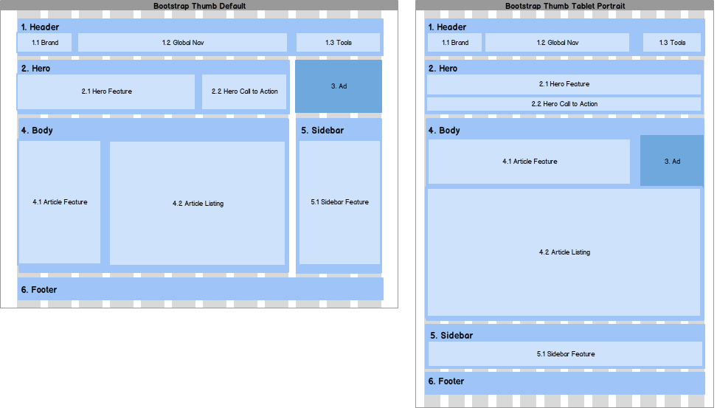
Bootstrap Grids
Here we can see an example of bootstraps grid system.
As the screen narrows the elements on the page rearrange.
This allows for a better mobile experience.

Slide 54
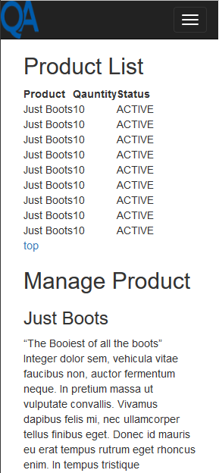
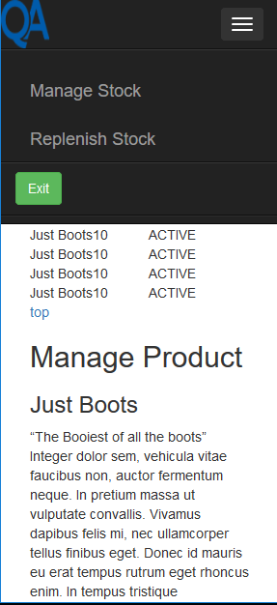
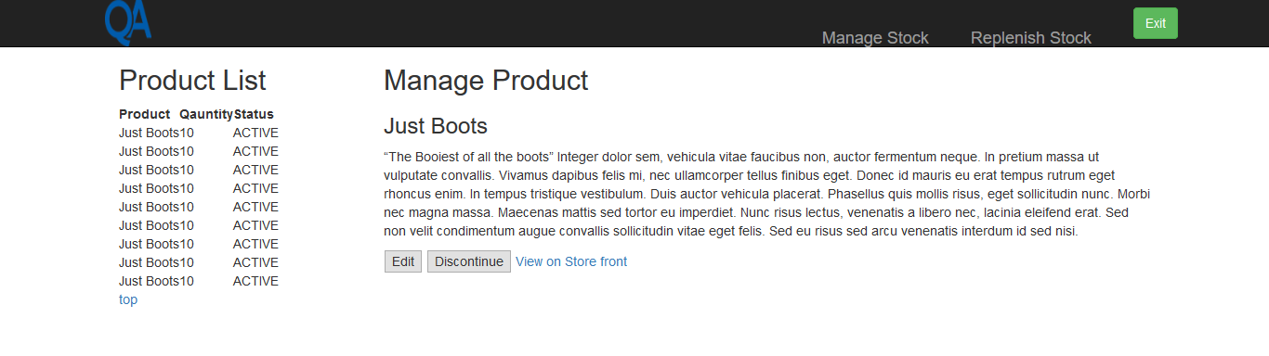
The Finished Page

Slide 55
Coding Challenge
Create 3 HTML pages
Edit it so that it suits the following criteria;
Pages:
Home
Project List
About me
The pages should not contain information provided initially in the template
Edit them to be more appropriate for you.
Home page should have an introduction to you and your site as well as navigation to your other pages
About me page should have the following content;
An introduction to who you are
Past achievements, future goals etc.
Basically an online copy of your CV
Project List page should be formatted in a way where you can have multiple posts on the page for your projects
Notes:
Feel free to use bootstrap!

Slide 56
Professional Front-End Web Development
JavaScript

Slide 57
Objectives
To discuss what JavaScript is and why its important.
Gain Practical knowledge with JavaScript

Slide 58
JavaScript - Introduction
Considered one of the most popular programming languages
Numerous frameworks are built on JS
Early in development, JavaScript had very poor implementations
Even though the reputation was damaged early on, JavaScript is seen as a very potent language
Recommended Reading – Most books are really bad and misleading! One of the least ‘Bad’ books is JavaScript: The Definitive Guide by Dave Flanagan

Slide 59
Characteristics of JavaScript
JavaScript is a functional language, and the most understood programming language
revolves around the creation and implementation of functions throughout the code
Typecast language
Even though ‘Java’ is part of the name, it’s not the same!
The term ‘script’ implies its not a real programming language, but this is not the case
JavaScript is ran in the browser
the browser is a hostile programming environment

Slide 60
Ways of Displaying Output
If you need to display an output, there are a number of ways to do it
document.write() – output to HTML
window.alert() – output through alert box
console.log() – output to browser console

Slide 61
Hello World
You can embed JavaScript in the HTML of your page, or use the console in your browser
<!DOCTYPE HTML>
<html>
<body>
<p>Before the script...</p>
<script>
window.alert('Hello, world!');
</script>
<p>...After the script.</p>
</body>
</html>

Slide 62
Variables in JavaScript
Declaring variables looks very similar in JavaScript to other programming languages
Declaring an object is done through the use of curly braces, with the information of that object being inside
var variableString = "hi";
var variableNumber = 3;
var variableObject = {
name:"Elliott“
};
window.alert(variableObject.name);

Slide 63
Case Sensitivity
Keywords in JS are lower case and case sensitive
Some methods are camel case, but the majority of keywords are lower case
Variables, parameters, members and function names conventionally start lower case
Constructors start upper case

Slide 64
Syntax
JavaScript bases its syntax on C
However, JavaScript allows functions to be values, which is what JS is all about
Identifiers in JS follow the same rules as C:
Start with a letter, an underscore ( _ ) or a dollar sign ( $ ), followed by zero or more instances of letters or these particular characters
By convention all variables, parameters members and function names start with lower case
Except for constructors which start with uppercase
Notes:
initial _ should be reserved for implementations
$ should be reserved for machines
meaning macro processors, program generators etc.
ajax community loves dollar signs and use them everywhere

Slide 65
Comments
Comments are declared through either:
//
/* */
var variableString = "hi";
//this is a comment
var totalNumber = 4;
/* this is a block comment,
hello friends */

Slide 66
Data Types
JS only has a small set of values.
Numbers
Strings
Booleans
Objects
Null
Undefined
Special value called NAN
Number(value) – Converts value to a number
parseInt(value,1) – Converts value to a number, stops at the first non digit character.
Notes:
Only one number type – 64bit and double, awful name for a type
It’s not very accurate, so always times your data by say 100, do the math, then revert it to decimals, 0.1 + 0.1 doesn’t always equal 0.2
NAN stands for “Not a number”
Toxic, any math performed with it will also output it.
NAN isn’t equal to anything, even itself, NAN = NAN is false.
NAN is not greater or less than NAN.
Even though it literally stands for Not A Number, it’s type is actually a number.
Number(value) produces NAN if it has a problem.
parseInt(value,1) – Second number is radix, always use it or you can get weird results.
Null = no value
Undefined = default value for variables and params
“The missing value, value”

Slide 67
Loosely Typed
Any of the previous types can be used anywhere.
Any variable can be used as a parameter to any function
However the language isn’t untyped
JS has a good sense of types, however it just means every type can be used everywhere.

Slide 68
Keywords
JS has a weird keyword policy
https://www.w3schools.com/js/js_reserved.asp
There’s a lot of reserved words, but the majority aren’t even used.

Slide 69
Operators
var x = 5; // assign the value 5 to x
var y = 2; // assign the value 2 to y
var z = x + y; // assign the value 7 to z
var z = x * y;
var z = x / y;
var z = x % y;
var z += y;
var z *= x;
&& || ! typeof instanceof
txt1 = "John";
txt2 = "Doe";
txt3 = txt1 + " " + txt2;
txt1 = "What a very ";
txt1 += "nice day";
x = 5 + 5;
y = "5" + 5;
z = "Hello" + 5;
Notes:
typeof prefix operator returns a string identifying the type of value.
It's not super good, as no matter what the object is it will return "object", if its an array it will return "object", if its null itll return "object", this is a mistake in the language.
However if you use it on string/function it’ll return "string"/"function"

Slide 70
Statements
if
switch
while
do
for
break
continue
return
try/throw

Slide 71
Coding Challenge 1
Variable declaration and output
Declare a variable
Store a value in it
Display the value via all 3 of the following methods;
Write it into the html doc
Output via alert
Output via console

Slide 72
Functions - Intro
First class objects
Functions can be passed, returned, and stored just like any variable.
Functions inherit from ‘Object’ and can store name/value pairs
Functions can appear anywhere that an expression can appear.
What JS calls a function, other languages call lambda
Since JS is Loosely Typed, you don’t have to declare parameter types in the signature.

Slide 73
Functions – Code Example
function myFunction(p1,p2){
return p1*p2;
}
var x = myFunction(4,3); //12
function foo() {}
Is almost the same as
var foo = function foo() {};
Functions share the same namespace as variables
Functions can be defined inside functions
An inner function has access to variables and params of functions it’s within.
This is known as Static/Lexical scoping

Slide 74
Arguments
When a function is invoked, in addition to its parameters it gets a special parameter called arguments
This contains all of the arguments from the invocation
It’s similar to an array (but strictly not)
This is useful when a function takes a lot of arguments you want to process easily.
function sum(a,b,c,d,e,f,g){
var i,
n = arguments.length,
total = 0;
for(i = 0; i < n; i++){
total += arguments[i];
}
return total;
}

Slide 75
Scope
Javascript { Block } does not have scope.
Very lazy coding when they were writing the language
This can cause a lot of confusion.
If you declare a variable anywhere in a function, the entire function has access to it.
If you declare the same variable twice, it’ll only be created once.
JS has implied globals
If you try and use a variable without declaring it, it’ll create a global one for you.
Notes:
This is good as it makes coding quicker to write but makes them buggier
JSLint is a tool that helps identify stuff like this, covered later.
A way to prevent implied globals is using Objects, as they have their own namespace. It’s almost like creating a package for your own variables. So when you’re using other scripts you don’t clash in namespace.

Slide 76
Variables - Tidbit
var myVariable = 10;
function func() {
myVariable = 25;
}
console.log(myVariable);
Console.log(myVariable);
Console.log(myVariable);
var myVariable;
var myVariable = 10;
function func() {
myVariable = 25;
var myVariable;
}
func();
console.log(myVariable);
Console.log(myVariable);
var myVariable = 10;
Notes:
Error, undefined, undefined, 10/25 (if function is called), 10
The second myVariable declaration is declared in “function scope” so the myVariable = 25 will select that one to assign 25 to, over the global one, then when we print out it’ll prefer the global one.
Hoisting is js default behaviour of moving all declarations to the top of the current scope.
"A var statement declares variables that are scoped to the running execution contexts VariableEnvironment. var variables are created when their containing lexical environment is instantiated and are initialized to undefined when created."
"variables are created when their environment is instantiated"
this is the hoisting bit.
its like it scans through the code for variable declarations, creates them as undefined, and then will execute code normally.
Best practice is to declare all your variables at the top of your scope, not always initialization but at least declaration to avoid confusion

Slide 77
Functions - Tidbit
Now you know about hoisting, how do the two types of methods differ?
Declaration Expression
function myFunc(){
console.log("Hi");
}
var expression = function(){
console.log("hi");
}
Notes:
Hoisting works with methods too, in the expression example if we try to call the method before it’s initialized, we’ll get undefined, in the first example it doesn’t matter when we call it.

Slide 78
Functions – Best Practice
Whenever you’re creating a function, follow this layout
Variables go first
Then functions
Then variables
Then functions
RunCode
var x = 10;
function print(input){
var x = 0;
function log(){
}
console.log(input);
}
print(10);
Notes:
Everytime you create a new scope, follow the same pattern.

Slide 79
Return
Every function has a return type, if you don’t declare it, it’ll simply return nothing.
Stops execution of the function and returns the specified value.
function myFunction() { return Math.PI; }
function myFunction(name) { return "Hello " + name; }

Slide 80
Objects
Collections of unordered name/value pairs
Names are strings
Values can be any type, including other objects.
Think of every object like a little database.
Values can also be expressions
: seperates names and values
, seperates pairs
Object literals can be used anywhere a value can appear.
//object literal
var myObject = {name: “Jack”, grade:”A”, level:3};
myObject.name = “Jeff”;
Window.alert(myObject.level); //outputs 3
//dynamic object
var exampleObject = new Object();
exampleObject.name = “Jeff”;
exampleObject.output = new function()…

Slide 81
Maker Functions
Another way to make objects, similar to constructors!
function maker(name,grade,level)
{
var it = {};
it.name = name;
it.grade = grade;
it.level = level;
return it;
}
var myObject = make("Jack","A",3);

Slide 82
Nested Literals
var myObject = {
name: "Jack",
grade: 'A',
format:{
type:'react',
width:1920,
height:1080,
interlace:false,
framerate:24
}
};
Objects within objects!
Notes:
If you ever find yourself passing a lot of data to a function via parameters, put them in an object!

Slide 83
Arrays
Arrays inherit from object
Indexes are converted to strings and used as names for retrieving values
Very efficient for sparse arrays
Not efficient in every other case.
No need to provide a length or type when creating an array
Arrays have a length member
Always one integer larger than the highest integer subscript.
Don’t use enhanced for loops for arrays
[] is preferred to new Array();
var myList = [‘oats’,’peas’,’beans’];
//adding a new member
myList[myList.length] = ‘barley’;

Slide 84
Arrays – p2
delete array[#]; to delete elements, but leave a hole.
myArray.splice(1,1); //to completely remove it, no hole
myArray= ['a','b','c','d'];
delete myArray[1];
//[a,undefined,c,d];
myArray.splice(1,1);
//[a,c,d]
Arrays have their own methods
Concat
Join
Populate
Push
Slice
Sort
Splice

Slide 85
Switch
switch(expression){
case ';':
case',':
case '.':
punctuation();
break;
default:
noneOfTheAbove();
}
Statement can use strings
Case value can be expressions, don’t have to be constants

Slide 86
Events
<html>
<head>
<script type="text/javascript">
function sayHello() {
alert("Hello World")
}
</script>
</head>
<body>
<form>
<input type="button" onclick="sayHello()" value="Say Hello" />
</form>
</body>
</html>
Events are a way of linking HTML to trigger JS code.
Such as;
Clicking on a button
Page load
Key presses
Etc.
Notes:
More events;
https://www.tutorialspoint.com/javascript/javascript_events.htm

Slide 87
Coding Challenge 2
Functions
Create a function accepts a number and outputs its square
Create a function that accepts 3 numbers and returns the sum of them.
Create a Person object with three values, name, age, occupation.
Output the contents of that object, then edit them, and output again.
Create a button that calls a function when clicked.
Create a button that increases the age of your Person object.

Slide 88
String
charAt
Concat
indexOf
lastIndexOf
Match
Replace
Search
Slice
Split
Substring
tolowerCase
toUpperCase
JS, unlike java, doesn’t have a char type
Characters are just one length strings.
Immutrable
Double or single quote work the same way
Length member
String(value) converts numbers into a string

Slide 89
String – Escape Characters
\’ – single quote
\” – double quote
\\ - backspace
\n – new line
\r – carriage return
\t - tab
\b - backspace
\f – form feed
\v – vertical tab
\0 – null character
Notes:
NB: \v and \0 aren’t allowed in JSON strings

Slide 90
Booleans – Truthy/Falsy
Boolean(value) returns true if the value is truthy, false if the value is falsy
Falsy values;
False
Null
Undefined
“”
0
NaN
Everything else is truthy.
Notes:
“0” is truthy
“false” is truthy

Slide 91
Coding Challenge 3
Strings
Create a variable with "He said "My name is elliott" " as the value. and then display it.
Using string methods, convert this string to uppercase and display it.
Perform an addition on a number variable and a string variable ("1" + 2 etc.)
Create an array with 3 strings and output them all.
Add another string with JS and output them.
Remove the last string from the array with JS and then output them.

Slide 92
Conditionals + More Operator tricks!
If(a){
return a.member;
}
Else{
return a;
}
//should be written as
return a && a.member;
-----------------------------------------------------
var last = input || defaultValue;
+ - used for addition and concatenation
+ - can also convert things into a number, e.g. +”42” = 42
== checks equality, but does type coercion
=== does equality of value and type
&& can be used to avoid null references
|| can be used fill in default values
! Returns the opposite of what something is.
!! Will convert anything to its boolean value, tidy!
Notes:
if both operators are numbers it’ll add them, if both are strings it’ll concatenate them. – this is a big mistake since it’s a loosely typed language, means you have to strictly put them in types before working with them.
Type coercion is where it’ll try and convert the type to make it pass, which isn’t always desireable
Netscape tried to make == do what === does but got denied, so now we have both!...
|| reads “if the input is truthy, use it, otherwise use the default value;

Slide 93
Equality
var x = 1;
var y = ‘1’;
If(x==y){
console.log(‘Equals’);
}
else{
console.log(“not equals”);
}
If(x){
…
}
//will blow up if it doesn’t exist
If(typeof x !== ‘undefined’){
…
}
//will execute if its NOT undefined, so if it exists.
Notes:
First one will print out equals, as it converts the second value to the type of the first value, and then check equality.
This is bad as it can become unpredictable and return things you might not expect.
=== doesn’t do type coercion

Slide 94
Coding challenge 4
Conditionals
Using conditional Statements, create a function that checks if your person object is between 20-40 years old

Slide 95
Loops
for(var i = 0; i< 10; i++)
{
console.log(i);
}
for(var name in object){
if(object.hasOwnProperty(name){
//do stuff
}
}
do{
Console.log(“hi”);
}while(true);
Notes:
The enhanced for loop works slightly weirdly in JS, it loops through all the keys that the object inherits from too, which isn’t desirable, so it requires the if statement to make sure that we’re only looping through the object we provide it.

Slide 96
Coding challenge 5 & 6
Loops 5
Fizz Buzz - Write a program that prints the numbers from 1 to 100. But for multiples of three print “Fizz” instead of the number and for the multiples of five print “Buzz”. For numbers which are multiples of both three and five print “FizzBuzz”.
Loops 6
First, you mash in a random large number to start with. Then, repeatedly do the following:
If the number is divisible by 3, divide it by 3.
If it's not, either add 1 or subtract 1 (to make it divisible by 3), then divide it by 3.
The game stops when you reach "1".

Slide 97
DOM Methods
The HTML DOM can be accessed via JS Methods
All elements are defined as Objects
This code changes the content of the p element with the id of demo to Hello World!
getElementById is a method
innerHTML is a property
<html>
<body>
<p id="demo"></p>
<script>
document.getElementById("demo").innerHTML = "Hello World!";
</script>
</body>
</html>
Notes:
Other DOM methods;
Document.createElement(element)
Document.write(text);
Document.getElementById(id).onclick = function() {code} ;
https://www.w3schools.com/js/js_htmldom_document.asp

Slide 98
Coding Challenge 7
DOM
In JS, create a function that creates a paragraph tag.
Another function that changes the text of that paragraph tag to what is in a textbox
Another function that deletes the paragraph tag
All of these functions should be called with a button(s).

Slide 99
JSON
Javascript Object Notation
Name:value,name2:value2
->Get request to JSON file
->Store response into jsonObject
->Work with it
var requestURL = 'https://raw.githubusercontent.com/womackx/JSONDataRepo/master/example.json';
var request = new XMLHttpRequest();
request.open('GET', requestURL);
request.responseType = 'json'
request.send();
request.onload = function() {
var superHeroes = request.response;
…

Slide 100
JSON
{
"squadName" : "Super hero squad",
"homeTown" : "Metro City",
"formed" : 2016,
"secretBase" : "Super tower",
"active" : true,
"members" : [
{
"name" : "Molecule Man",
"age" : 29,
"secretIdentity" : "Dan Jukes",
"powers" : [
"Radiation resistance",
"Turning tiny",
"Radiation blast"
]
},
var myH1 = document.createElement('h1');
myH1.textContent = jsonObj['squadName'];
document.getElementsByTagName('head')[0].appendChild(myH1);

Slide 101
Coding Challenge 8 & 9 - JSON
Using VanillaJS, access the JSON file at this address
https://github.com/womackx/JSONDataRepo/blob/master/example.json
Once loaded, display those objects on your page.
Similarly, load this JSON file at this address
https://github.com/womackx/JSONDataRepo/blob/master/kings.json
Instead of loading all the object on the page, have a text box that will take an attribute that belongs to these objects, and output the contents of the specific object it’s associated with.

Slide 102
Coding Challenge 10 – Garage Project
Create a virtual garage with the following functionality;
Check in cars to the garage
Check out cars
Output the contents of the garage
Calculate the bill for a car, dependant on its attributes
All of these should be able to be done via a user interface, as well as the following non-garage related features;
Creating cars
Creating cars with no faults
Creating cars with numerous faults

Slide 103
Coding Challenge 11 – Garage Admin Interface
Once the initial garage application is done, create a console interface that accepts commands to perform the previous commands via the console, instead of the interface e.g.
add car Peugeot yk10ykm 4
output Garage
check in yk10ykm
bill yk10ykm
garage changeLimit 10
garage empty
Which will output the changes in the console after being ran.
The commands must be oneliners.

Slide 104
JS Best Practices

Slide 105
Style
Programming isn’t about personal taste
It’s rigor in expression
It’s clearness in presentation
It’s product adaptability/longevity
Style is more important in JS than most languages
Because of the “softness” of the language
DISCIPLINE IS NECESSARY!
90% of JS programs out there are awfully made.

Slide 106
Syntax
Semicolons
Linting
Variables
Functions

Slide 107
Semicolons
Semi colons are optional
Although they shouldn’t be
JS puts them in for you, if you don’t put them in.
THIS IS REALLY BAD
IT CAN BREAK YOUR CODE!

Slide 108
ASI – Automatic Semicolon Insertion
There are 3 rules that JS follows for ASI
When a script or module is parsed from left to right, if a token is encountered that is not allowed by any production of the grammar.
When a script or module is parsed from left to right, the end of the input stream of tokens is encountered.
When a token is encountered that is allowed by some production of the grammar but the production is a restricted production and the token would be the first token of a restricted production, and the restricted token is separated from the previous token by at least one line termination.
Then a semi colon is inserted.
Notes:
#2 just means end of file it’ll put one in, np
Restricted production is a fancy way of saying continue/break/return/throw, if it encounters one of these and then a line terminator, it’ll put a SC in.

Slide 109
Rule #1
var a = 12
var b = 13
if(a) { console.log(a) }
console.log(a+b)
var a = 12<- rule 1a
var b = 13 <- rule 1a
var c = b + a
['menu', 'items', 'listed']
.forEach(function (element){
console.log(element) -< rule 1 b
})
Notes:
In this case, the v of var b = 13 doesn’t make sense, so it puts a SC between them.
If the offending token is separated from the previous token by at least one line terminator
If the offending token is a curly brace }, then we put a semi colon in between.
[] is an allowed character after b+a, so it wont put a SC there, but then we’re gonna get an error since it’s looking for something that doesn’t exist.

Slide 110
Rule #1
var a = 12
var b = 13
var c = b+ a
(function() {
console.log('inside my life');
console.log('doing secret stuff...');
}())
Notes:
( is an allowed character after a, so it won’t get a semi colon, but again we’ll get an error.
This is a common issue when loading in multiple scripts.

Slide 111
Rule #3
function returnObject(){
if (someTrueThing)
{
return
{
hi: 'hello'
}
}
}
Notes:
This will put a semicolon after the return, meaning h1 isn’t going to be executed or be returned, not good!
You can live without using them, but you’re prone to getting bugs if so, I’d highly recommend you just use them everywhere.

Slide 112
Linting
Linting is an external program that will scan your code to detect errors
Enforces style rules
Spot difficult to see errors
Eliminate implied globals
IT WILL HURT YOUR FEELINGS
There are a lot of different ones with their own benefits;
JSHint – very configurable, built in package support, not extensible.
ESLint – custom rule support, lots of configuration, hard to use.
Notes:
JSHint is recommended
jshint.com/code
Brackets plugin, or ATOM plugin

Slide 113
Brackets
Always put your first curly bracket on the same line as the declaration, this is because of ASI rule #3
Might get a semicolon between them otherwise, not good!
Good:
function funcName() {
...
}
Bad:
function funcName()
{
...
}

Slide 114
Coding Standard
Break a line after any punctuator
Don’t break a line after a name, string, number, or ) ] ++ --
Avoid tricky expressions using comma operator
Do not use extra commas in array literals
Good: [1,2,3];
Bad: [1,2,3,];
Opening bracket on the start of your function
Always use brackets if you can,
Not if(a) //code
If(a) { //code }
Notes:
Why is an extra comma bad? – Different browsers interpret this different, returning different lengths, some count by elements, some count by commas!

Slide 115
More Behaviours
JS has a lot of behaviours to help you out.
ASI is the most problematic behaviour
Implied globals is a close second.

Slide 116
Implied Globals
var toPrint = "print";
function print(out){
var stringToPrint = out;
}
console.log(stringtoPrint);
print("hello");
var toPrint = "print";
function print(out){
var stringToPrint = out;
console.log(stringtoPrint);
console.log(toPrint);
}
print("hello");
var toPrint = "print";
function print(out){
stringToPrint = out;
}
console.log(stringtoPrint);
print("hello");
Notes:
Good/bad/good
When it goes through the function, it sees that you need a “stringToPrint” reference, but it doesn’t have it since it was never declared.
So the compiler looks in the function scope for it, doesn’t find it, asks the global scope for it, and then if that doesn’t have it either, it thinks “well you clearly meant to make one, here you go!” and it becomes GLOBAL.
This is bad.

Slide 117
Strict mode
Strict mode slaps JS on the wrist every time it tries to help you.
Can I create a variable for you? No, throw an exception!
Can I put a semi colon in for you? No, throw an exception!
Can I try and handle this bad code? No, throw an exception!
Can I help you out when you make any mistake? NO, TELL ME I’M WRONG!
To enable this, simply write ‘use strict’; at the top of your JS script
If you only want it to apply to certain scopes, like a function, put it at the top of your function.
Strict will make you a better programmer!

Slide 118
Read Only Properties
var obj = {}
Object.defineProperty(obj, 'readOnly', {
enumerable: false,
configurable: false,
writable: false,
value: "This var is read only"
});
console.log(obj.readOnly)
We can define properties with some settings
Enumerable (Loopable)
Configurable
Writable (Ability to change it)
Value
If you try to write to a non-writable property, you wont get an error but it also wont change the value.
If you have use strict enabled, you will get an error.

Slide 119
Deleting Properties
var obj = {a: 100, b:200};
var myVar = 10;
delete obj.a;
console.log(obj);
If you try to delete a property, but later access it, it won’t delete it
Use strict will force it to be deleted.

Slide 120
Duplications
function x(a,b,a)
{
console.log(a);
}
x(1,2,3);
//this outputs 3
You can technically have a function with two parameters sharing the same name.
This is bad as it can cause unpredictable results
use strict will give you an error if this is the case

Slide 121
Octals/Hexadecimals
012 = 10 in Octal
If we enable use strict, it will complain about 0s before a number.
If we want to use octal/hexadecimal;
parseInt(12,8)
This parses the integer 12, in the octal format.

Slide 122
With
var obj = {
a: {
b: {
c: 'hello'
}
}
}
console.log(obj.a.b.c);
//same as
with(obj.a.b)
{
console.log(c);
}
The with keyword is a way of simplifying some lines of code
But it has a lot of problems
If we had a var c before the with, we don’t know which c it would be referring too.
Use strict simply disables with statements

Slide 123
With – Alternative (IIFE)
What with attempts to do, is useful.
Just done badly.
We have “IIFE” instead
Immediately invoked function expression
(function(newVar){
console.log(newVar);
}(obj.a.b.c))

Slide 124
This
var obj = {
val:'Hi there',
printVal: function() {
console.log(this.obj);
}
};
var obj2 = {
val: "whats up"
};
obj2.printVal = obj.printVal;
This is the most confusing thing in JS
It’s used to reach inside the containing object.
Use strict will make the global object unbindable
at least implicitly
var print = obj.printVal();
//what does this refer to now?
Notes:
In this example we copy the printVal function from obj into obj2 to save time.
So now this refers to obj2 instead of obj, good.
This can bind to the global object/scope, this is bad
Now it’ll print out the entire contents of the global object, which is massive and useless.

Slide 125
This - Alternatives
var print = obj.printVal().bind(obj2);
//will act asif it’s acting on obj2
var obj = function(){
this.hello = "hello";
this.greet = function(){
console.log(this.hello);
}
}
obj();
//or treat it like a constructor
Var greeter = new obj();

Slide 126
Behaviours - Summary
use strict mode

Slide 127
Efficiency
Strings
Like java, concatenating strings is inefficient
Use array.join
foo = [a,b].join('');
Minification
Reduces the amount of source code to minimize download time
Deletes whitespace and comments
Shortens variable name size
Obfuscation
Changes the name of things to make your code unreadable
Can introduce bugs

Slide 128
Advanced JS

Slide 129
Objectives to Learn
Load and go delivery
Loose typing
Objects as general containers
Prototypal inheritance
Lambda
Linkage through global variables
Notes:
Load and go delivery - programs are delivered to the execution site as the source code, not an exe or anything, literally just the code.
reason for that is so that it can be embedded into web pages, which are text, super convenient.
Loose typing - controversial, fashion right now is strong typing so compilers can check everything, loose typing has benefits though, easier to write.
Objects as general containers - great idea, unification of objects and hash tables, objects are completely dynamic so attributes and functions can be added to them at any time.
Prototypal inheritance - different than class inheritance which is common in other languages, objects inherit from other objects. powerful idea but not really understood very well, very powerful and effective.
Lambda - use of functions as first class objects, super powerful idea.
Linkage through global variables – because of the load and go model, there’s no linking, so separate compilation units are combined through a common global namespace, which is a really bad idea, security issues, reliability

Slide 130
Classical vs Prototypal Inheritance
Classical
Objects are instances of classes
Classes inherit from other classes
Prototypal
Class free
Objects inherit from objects
Objects contain links to other objects
var oldObject = {
firstMethod: function() {...},
secondMethod: function() {...}
};
//creates an object to inherit from the old object
var newObject = object(oldObject);
newObject.thirdMethod = function() {...};
var myDoppelGanger = object(newObject);
myDoppelGanger.firstMethod();
Notes:
JS Notation can be really confusing as it’s trying to look like a classical pattern, but functioning like prototypal, ugh.

Slide 131
Linkage
Objects can be created with a secret link to another object.
If an attempt to access a name fails, then the linked object will be used.
The secret link is not used when storing.
Object(o) makes a new object with a link to object o
This function technically doesn’t exist, so you have to create it.
Any object can inherit from any object
function object(o) {
function F() {}
f.prototype = o;
return new F();
}
var myNewObject = object(myOldObject);
//creates an empty object that has a pointer to the old object
myNewObject.name = "Tom";
myNewObject.level += 1;
Notes:
Since it didn’t have a name, it’ll create a name value for our myNewObject.
Since it didn’t have a level, it’ll look in the old object to get the level, then store the new increment in the new object.
This provides our simple inheritance mechanism!

Slide 132
Object Augmentation
Take an existing object – then add new things onto it
As simple as an assignment
var obj = {a: 100, b:200};
obj.chocolateFactory = “Dog”
obj.methodName = function()…

Slide 133
Invocation
If a function is called with too many arguments, the extra ones are ignored
If a function is called with too few arguments, the missing arguments will be undefined.
No type checking on arguments
Four ways of calling a function.
Function form
Method form
Constructor Form
Apply Form
The first three are the most common
Function form
functionObject(arguments)
Method form
thisObject.methodName(arguments);
thisObject["methodName"](arguments)
Constructor form
new functionObject(arguments)
Apply form
functionObject.apply(thisObject,[arguments]);

Slide 134
Augmenting Types
In JS we can augment the built in types;
Object.prototype
Array.prototype
Function.prototype
Number.prototype
String.prototype
Boolean.prototype
Unlike some languages, JS doesn’t have loads of String methods like trim()
So we can create our own!
String.prototype.trim = function(a,b) {
return this.replace(a,b);
};

Slide 135
Closure
An inner function that has access to the outer functions scope chain
Closure has 3 scope chains
It’s own scope
Outer function scope
Global scope
Allows us to write code that is;
Creative
Expressive
Concise

Slide 136
Closure
function showName (firstName, lastName) {
​var nameIntro = "Your name is ";
// this inner function has access to the outer function's variables, including the parameter​
​function makeFullName () {
​ return nameIntro + firstName + " " + lastName;
}
​​return makeFullName ();
}
​showName ("Michael", "Jackson");
// Your name is Michael Jackson
Closure is a function inside another function.

Slide 137
Closures’ Rules & Side Effects
function celebrityName (firstName) {
var nameIntro = "This celebrity is ";
function lastName (theLastName) {
return nameIntro + firstName + " " + theLastName;
}
return lastName;
}
​
​var mjName = celebrityName ("Michael");
// At this juncture, the celebrityName outer function has returned.​​
​// The closure (lastName) is called here after the outer function has returned above​
​// Yet, the closure still has access to the outer function's variables and parameter​
mjName ("Jackson"); // This celebrity is Michael Jackson
Closures have access to the outer functions variable even after the outer function returns
Notes:
One of the most important features is that the inner function still has access to the outer functions variables even after the outer function has returned. When JS functions execute they use the same scope that was in effect when they were created, this means that even after the outer function has returned the inner function still has access to the variables later in your program.

Slide 138
Closures’ Rules and Side Effects
function celebrityID () {
var celebrityID = 999;
// We are returning an object with some inner functions​
return {
getID: function () {
return celebrityID;
},
setID: function (theNewID) {
celebrityID = theNewID;
}
}
}​
​var mjID = celebrityID ();
// At this juncture, the celebrityID outer function has returned.​
mjID.getID(); // 999​
mjID.setID(567); // Changes the outer function's variable​
mjID.getID(); // 567: It returns the updated celebrityId variable
2. Closures store references to the outer function’s variables
Notes:
They do not store the actual value, closures get more interesting when the value of the outer functions’ variable changes before the closure is called. This powerful feature can be harnessed I creative ways, such as this private variables example.

Slide 139
Thank you
QA hopes you enjoyed your course,
as much as we enjoyed teaching you.

